Slide 1


Chapter 4
Creating a Virtual Machine
Virtualization Essentials

Slide 2
Chapter 4 Objectives
Understand P2V (Physical-to-Virtual) conversions
Load VMware Player as the virtualization environment
Load Oracle VirtualBox as a virtualization environment
Create a new virtual machine
2

Slide 3
The P2V Process
P2V creates virtual machines using existing physical servers as their templates.
Consolidation: Removing physical servers from a datacenter by virtualizing them onto fewer hosts
Containment: Deploying new applications directly into a virtual environment
3

Slide 4
Hot and Cold Cloning
Hot cloning creates a virtual machine while the source workload is active; no application interruption is necessary
Cold cloning requires the application to be inactive; possibly the rate of data change is too rapid for the P2V to ever complete
There are many vendor and third-party tools to perform not just P2V but V2V and V2P as well
4

Slide 5
Using VMware Player
VMware Workstation Player is a Type 2 hypervisor
With it you can create, manage, and run virtual machines
Free download at www.vmware.com/downloads
Other popular tools include:
VMware Workstation Pro
VMware Fusion (for Macintosh)
Parallels Desktop
Virtual Box (open source)
Microsoft Windows Virtual PC
5

Slide 6
New Virtual Machines
Creating new VMs is usually associated with containment or development
Creating a new VM “builds” only the virtual hardware
Operating system and application software are both added later
You can power on a new virtual machine just like you can power on a physical server without an operating system
6

Slide 7
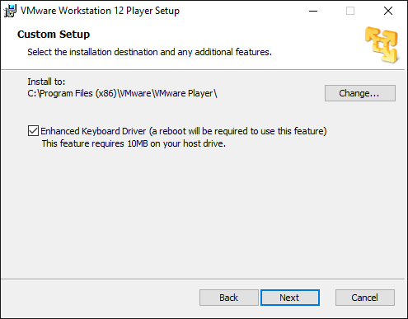
Loading VMware Player
As a Type 2 hypervisor it is installed like most Windows applications
Simple (minimal configuration options)
7

Slide 8
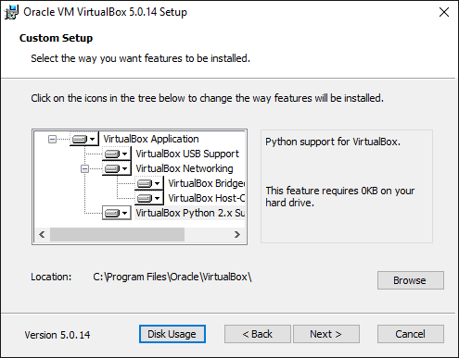
Loading Oracle VirtualBox
As a Type 2 hypervisor, it is installed like most Windows applications
Simple (minimal configuration options)
8

Slide 9
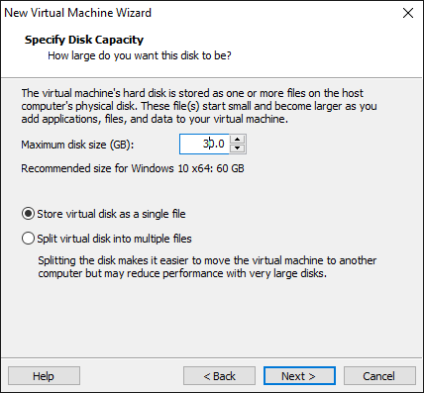
Building a New Virtual Machine
Creating a new VM is really all about configuring the virtual hardware
How many vCPUs? How much memory? How much storage? Etc.
Process is wizard driven
For our example, remember to select “Store virtual disk as a single file”
9

Slide 10
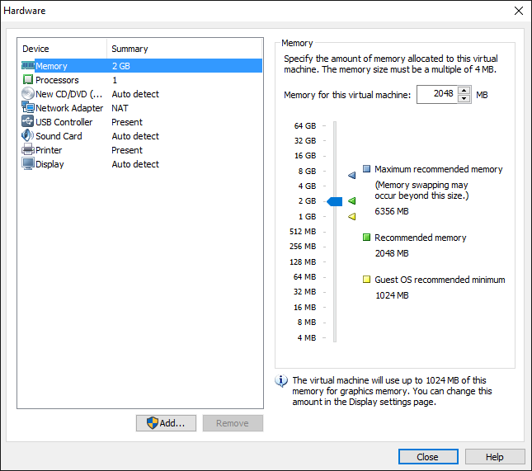
Finishing Touches
Some (virtual) hardware devices are added by default; others can be added based on need
10

Slide 11
Chapter 4 Summary
P2V technologies provide a rapid and automated method for moving existing physical server workloads into virtual environments
VMware Player is a Type 2 hypervisor; it is one possible tool to use for these efforts
Creating a new virtual machine is a simple process
11

